Slide 1
PERIFERICO TIJUANA Status Report
May 2018

Slide 2
VIDEO PROJECT´S PRESENTATION
DESCRIPTIVE VIDEO - INFOGRAPHY

Slide 3
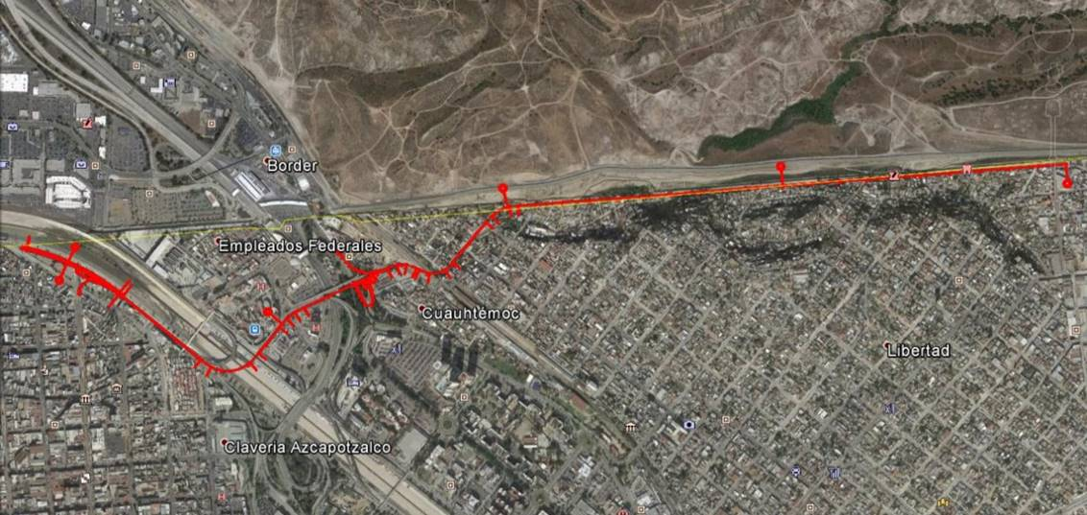
PERIFERICO TIJUANA

Slide 4
PROJECT ´S TIMELINE
Time Line
Feb
Aug
Mar
Jun
Sep
Dec
Jan
Feb
Mar
Sep
Oct
Nov
Dec
Jan
Feb
Jun
Nov
Dec
Mar
Five Clarification Meetings
Sep 7th 2016 to Oct 14th 2016
Statement of Interest
Feb 26th 2015
Unsolicited Proposal (UP) Submission
Jan 29th 2016
VETSA Certificate of Incorporation
Jun 15th 2017
PPP signing 2018/ SIDUE
RELEVANT MILESTONES TO DATE
2018
UP Approval
Apr 22th 2016
Technical Proposals’ Presentation and Opening
Jan 5th 2017
Ruling
Mar 24th 2017
Confirmation for presenting the project
Mar 6th 2015
Public Announcement of Bidding Process
Ago 12th 2016
Economic Proposals’ Presentation an Opening
Feb 23rd 2017
*PPP = Public -Private Partnership

Slide 5
PROJECT’S FEASIBILITY VALUATION
In the process for developing the Unsolicited Proposal ( UP) three assessments were made
Economic and Financial - Blackrock and KPMG
Legal - Galicia & Asociados + De Hoyos
Technical - Prointec, Tool Alfa
In the UP analysis process, the Infrastructure Department (SIDUE), the State´s Legal Body, and the Department of Finance (SHCP), studied and approved the viability of the UP calling, therefore, for a tender.
The Administrative and Fiscal Agency of BC’s Congress (ORFIS), Congress’ Financial Committee, and finally, Congress itself, through Decree 58, approved the signing of the PPP Project Contract with the previous condition of approving the maximum amount assigned to the Project (the guarantee).
ORFIS has already produced a positive report for the new decree.
Only Congress’ final approval remains pending, regarding the State’s guarantee need to finance the Project.
Economic and Financial Assessment
Legal Assessment
Technical Assessment

Slide 6
PROJECT WITH ITS OWN REVENUE SOURCE (Toll Fee)
We estimate that the “Periferico Aeropuerto” (Airport ring road) will be use daily by 6,000 trucks and by 16,000 cars.
The toll is not yet defined, but it will be between MXN 10,00 to 20,00 (USD 0.50 – 1.00) for cars and for the whole viaduct 4.2 km. long.
Trucks will pay, depending of their axles, between 2.5 – 4.00 times of the car´s toll.
Mexico’s City “Segundo Piso” Ring Road has a fee per Km. of MXN 5.96 (USD 0.30)
Key Biscayne Bridge, in Miami, has a fee per Km. of MXN 11.26 (USD 0.58)
“Periferico Aeropuerto” fee per Km. will be between MXN 2.38 – 4.76 (USD 0.12 – 0.24)
The toll fee will cover the payment for the Operator and the surplus will go directly to the Trust .
The BC State´s contribution is limited to guarantee this payment, whose primary source will be the toll fee.

Slide 7
ECONOMIC BENEFITS
MXN Millions
Toll Income
The project will involve a direct investment in the area of MXN 1,400.00 m. (USD 72.00 m.) over a period of 26 months, creating 600 direct jobs.
During the 27 years of operation there will be an investment, to maintain and operate the infrastructure, of MXN 1,700.00 m. (USD 87.00 m.) at present value, and will create 50 direct jobs.
Guarantee
300
T 1 Infrastructure Payment
T 2 Operation Cost
T 3 Right of Way Payment
20 months
CONSTRUCTION
OPERATION
27 Years
Total CAPEX | MXN 1,400.00
Maintenance, Operation and Administration Cost MXN 1,300.00
Conservation Cost MXN 400.00

Slide 8
PPP ORGANIZATION’S CHART
MASTER TRUST
2% s/payroll
TOLL FEE
$$$
PPP Contract
PROJECT’S TRUST
FINANCING
Debt Repayment
Payment
Construction, Operation
Maintenance and Conservation

Slide 9
SOCIAL PROFITABILITY The defined project substantially improves the road functionality in the environment where the infrastructure is located, contributing to the development of business activities and the consequent increase in prosperity and social welfare.
The direct social improvements offered by the implementation of the Project are:
Reduction of CO2 emissions due to the increase of speed in vehicles, along the route, reducing the times in short travels.
Increase in road´s safety and reduction of traffic accidents.
Decrease in fuel consumption and vehicle maintenance costs.
Esthetic improvement of the border front where the corridor is implanted
Reduced travel time.
Enhancement of family ties between sister cities.
The business activities of the following groups of interest will be favored: Industrial Sector, Tourism Sector, Real Estate Sector, Health Sector, Education Sector and Social Sector
The direct functional improvements offered by the implementation of the Project are:
Mobility and traffic improvement in the metropolitan area.
Direct connection between the East - West areas of the city.
Accessibility improvement to the international airport.
Better access to the border crossing from different points of the city, which is highly congested on a regular basis.
Closure of the first high capacity bypass of the city to complete the ring formed by the Libramiento Sur, recently executed by the Administration.

Slide 10
OUR CITY DESERVES THE BEST

